Slide 1

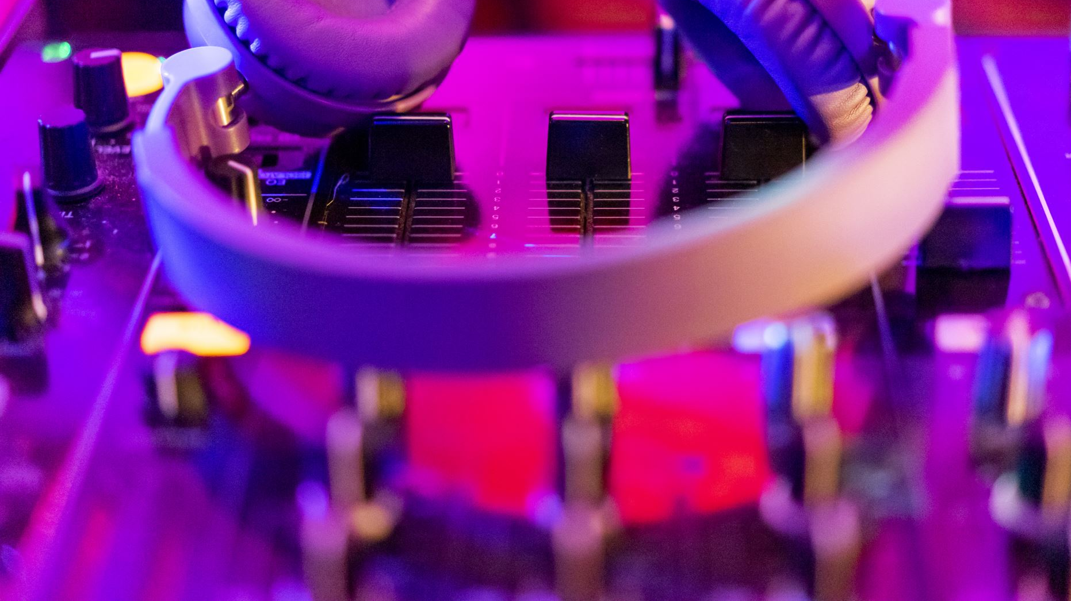
Audio playback using DMA
By:
Kumar sai reddy guntaka

Slide 2




Features Used
Not used | used
4 user switches | X
4 user LEDs | X
5 user push buttons |  | X
USB-UART Bridge |  | X
Micro SD card connector | X
HDMI Sink and HDMI Source | X
16 Bit VGA port | X
Audio codec w/ three 3.5mm jacks |  | X
User EEPROM | X
10/100/1000 Ethernet PHY | X
512MiB 800Mt/s DDR3 Memory |  | X
Serial Flash | X
Five Pmod ports | X
Pmod for XADC signals | X
USB HID Host | X

Slide 3
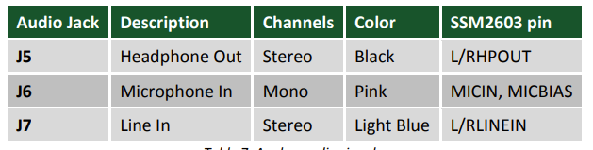
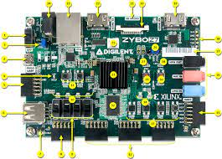
Audio:
An Analog Devices SSM2603 Audio Codec provides integrated digital audio processing to the Zynq-7000 AP SoC. It allows for stereo record and playback at sample rates from 8 kHz to 96 kHz.
On the analog side, the codec connects to three 3.5 mm standard audio jacks. There are two inputs: a mono microphone and a stereo line in. There is one stereo output, the headphone jack. Analog power is provided by a dedicated linear power supply (IC5).

Slide 4
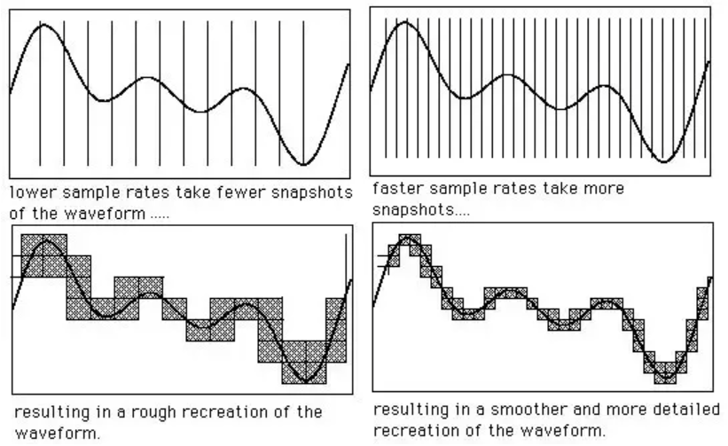
Sampling Rate:
Sampling rate or sampling frequency defines the number of samples per second (or per another unit) taken from a continuous signal to make a discrete or digital signal.
f_{s} = 1/T.
f Nyqu = 2 f i n , max.
In audio production, a sample rate (or "sampling rate") defines how many times per second a sound is sampled. Technically speaking, it is the frequency of samples used in a digital recording.

Slide 5
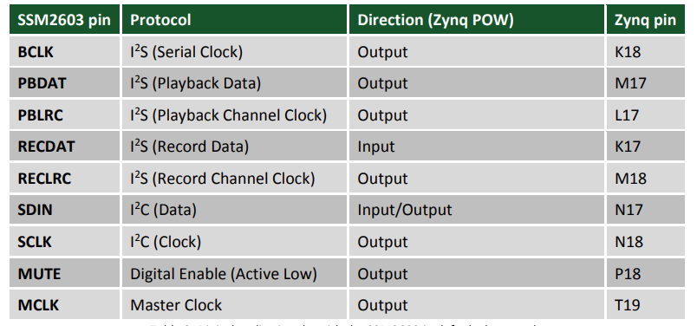
Protocols:
The digital interface of the SSM2603 is wired to the programmable logic side of the Zynq. Audio data is transferred via the I²S protocol. Configuration is done over an I2C bus. The device address of the SSM2603 is 0011010b. All digital I/O are 3.3V level and connect to a 3.3V-powered FPGA bank.

Slide 6
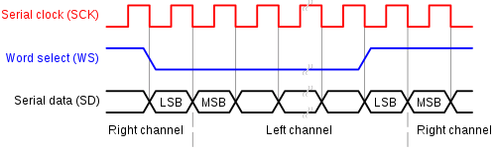
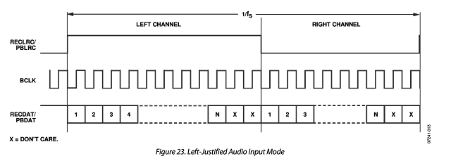
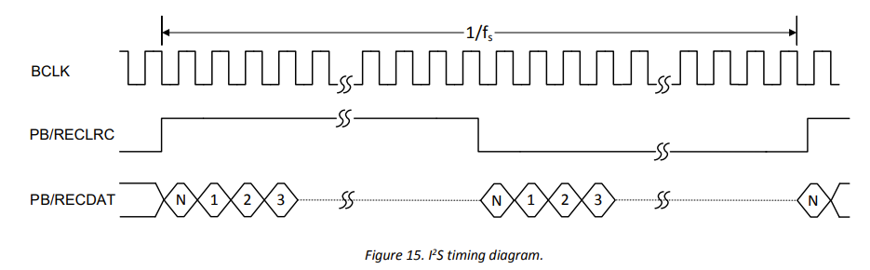
Implementing I2S protocol:
I²S (Inter-IC Sound, is an electrical serial bus interface standard used for connecting digital audio devices together. It is used to communicate PCM audio data between integrated circuits in an electronic device. The I²S bus separates clock and serial data signals, resulting in simpler receivers than those required for asynchronous communications systems that need to recover the clock from the data stream

Slide 7
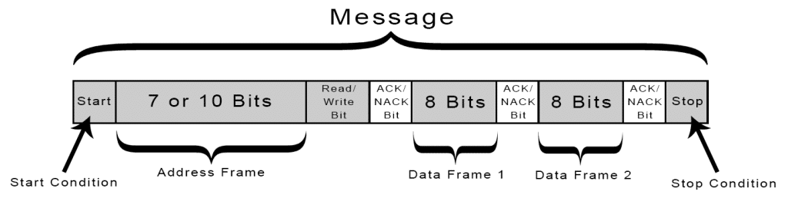
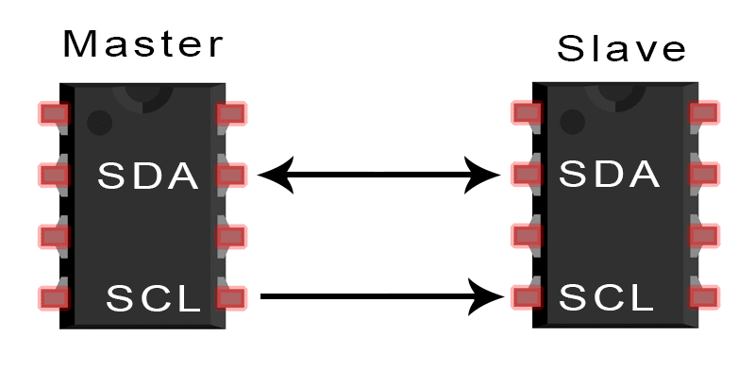
I2C Communication Protocol:
I2C stands for Inter-Integrated Circuit. It is a bus interface connection protocol incorporated into devices for serial communication. It was originally designed by Philips Semiconductor in 1982. Recently, it is a widely used protocol for short-distance communication. It is also known as Two Wired Interface(TWI).

Slide 8
Vivado:
Hardware implementation:
Add IP’s.
Configure the blocks.
Validate the design.
Create the HDL wrapper.
Generate bitstream.
And export the hardware.

Slide 9

Let's discuss about few IP’s used in project and their configuration.

Slide 10

Source Code:

Slide 11
Software Implementation:
Button | Function
BTN0 | no effect
BTN1 | record from mic in
BTN2 | play on hph out
BTN3 | record from line in
Open Xilinx SDK and add the source files that which we discussed.
Build the project
Program the device.
Add port in SDK terminal where you can see the instructions.

Slide 12

Demo:
https://drive.google.com/file/d/1eyTRJqBjKK-WUUt6TKoq4aMENxMIuqsf/view?usp=sharing

Slide 13
Thank you

